Slide 1
B’nai Mitzvah Inclusion Guide

Slide 2
Overview of Units
Unit 1: Relationship-Building: The Key to Success
Unit 2: Teaching Trope and Hebrew to Diverse Learners
Unit 3: Tackling the D’var Torah
Unit 4: The Main Event
Unit 5: Mitzvah Projects
Unit 6: Case Studies
Unit 7: Navigating the “Big Day”
Unit 8: Technology, Virtual Learning and Additional Resources

Slide 3
Unit 1: Relationship-Building: The Key to Success

Slide 4
Unit 1 - Big Ideas
Each family has their own unique goals for their child’s b’nai mitzvah.
The process for achieving those goals is different for each family.
Every child is an individual with their own set of learning styles, needs and strengths.

Slide 5
Facilitating a Conversation
Facilitate a conversation before beginning instruction.
Set goals with the parents and student together.
Set the goals verbally or write them down.

Slide 6
Questions for the Parent/ Guardian
What do you want your child to get out of this experience?
What is your reason for having this bar/bat mitzvah?
What do you want your family to get out of this experience?
How much of the service do you want your child to lead?
How many prayers do you want them to learn?
How many aliyot do you want them to read from the Torah?

Slide 7
Questions for the Parent/ Guardian continued
Do you want them to give a d’var Torah?
Do you want your child to learn trope? Is it okay if they use a recording?
Do you want them to create a mitzvah project?
How independent do you want your child to be during the process?
Are there other members of your child’s team that should be included in the planning? (OT, speech therapist, psychologist, etc.)
Do you have an image/vision for the day?

Slide 8
Questions for the Student
What do you want to get out of the experience?
What is your reason for having this bar/bat mitzvah?
How much are you, the student, capable and comfortable with leading?
What prayers do you already know?
Are you able to read Hebrew?
Are you interested in a mitzvah project?
Do you have an image/vision for the day?

Slide 9
Family Considerations
What is the best way to communicate with the family?
Who in the family is going to help the student stay accountable for practicing?
Are the student’s parents divorced or separated?
Be aware of the family’s financial considerations.

Slide 10
Family Case Study #1
You and the student’s parents are meeting to discuss how often the student needs to study, and how he can stay accountable. The student has poor executive functioning skills and will not be able to manage the schedule on his own. You suggest that the parents remind the student each day, but the parents stay late at work and will not be available to help in this way.
What ideas can you contribute to set the student up for success?

Slide 11
Family Case Study #2
Your student has a language-based learning disability. She attends a school where she receives language and social/emotional support. The bat mitzvah process is very overwhelming to her and feels like an extra burden on top of her academic pressures. The parents feel strongly that she should have a traditional bat mitzvah.
How can you help this family be successful?

Slide 12
Family Case Study #3
Your student has a disability and is not very aware of their own limitations. They have seen members of their community read from the Torah and lead prayers at their b’nai mitzvah, and this is their understanding of what a b’nai mitzvah is. The parents believe the student should have an adapted service, requiring them to learn fewer aliyot and prayers.
How can we ensure success for this family?

Slide 13
Identify Your Learning Styles and Strengths
You are an individual.
You learn in your own way.
You have your own interests.
You have your own unique way of operating in the world around you.
Let’s dig deeper!

Slide 14
Your Learning Profile
Click this picture for the Learning Style Inventory Sample.

Slide 15
If you answered mostly A’s...
Visual Learner:
You learn by seeing and looking.
You take numerous detailed notes.
You tend to sit in the front.
You are usually neat and clean.
You often close your eyes to visualize or remember something.
You find something to watch if you are bored.
You like to see what you are learning.
You benefit from illustrations and presentations that use color.
You are attracted to written or spoken language rich in imagery.
You prefer stimuli to be isolated from auditory and kinesthetic distraction.
You find passive surroundings ideal.

Slide 16
If you answered mostly B’s...
Auditory Learner:
You learn by hearing and listening.
You sit where you can hear but don’t pay attention to what is happening in the front.
You may not coordinate colors or clothes but can explain why you are wearing what you are wearing.
You hum or talk to yourself or others when bored.
You acquire knowledge by reading aloud.
You remember by verbalizing lessons to yourself.

Slide 17
If you answered mostly C’s...
Kinesthetic Learner:
You learn by touching and doing.
You need to be active and take frequent breaks.
You speak with your hands and with gestures.
You remember what was done but have difficulty recalling what was said or seen.
You find reasons to tinker or move when bored.
You rely on what you can directly experience or perform.
Activities such as cooking, construction, engineering and art help you perceive and learn.
You enjoy field trips and tasks that involve manipulating materials.
You sit near the door or someplace else where you can easily get up and move around.
You are uncomfortable in classrooms where there is a lack of opportunities for hands-on experience.
You communicate by touching and appreciate physically expressed encouragement such as a pat on the back.

Slide 18
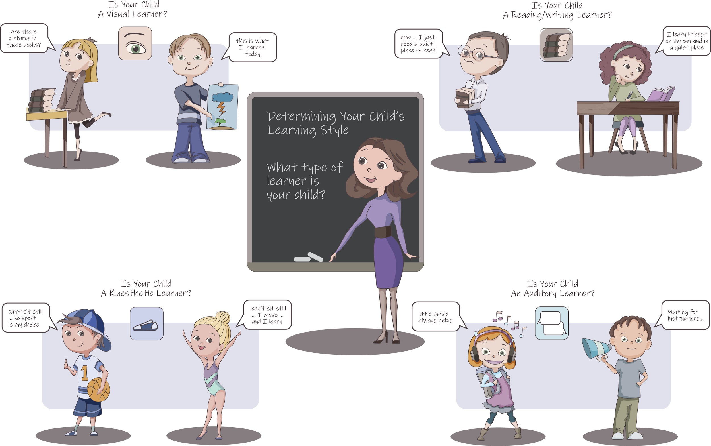
Notes:
What do you notice in this picture? What does it tell you about diverse learners?

Slide 19
Auditory Learners
Auditory Learners learn best while they are actively listening.
Often ingest information through audio or video clips or by discussing a topic.
Listening intently
Sometimes appear disruptive or uninterested in class.
They think in words, like wordplay and puns, and love telling stories.
Memorize things easily, from dates and spelling words to trivia — one reason they know all the words to their favorite songs.
Strategies:
Make a recording for the student to listen to
Discuss the d’var torah together rather than reading/ writing about it
Resource: https://tutoringwithatwist.ca/vark-learning-styles/

Slide 20
Visual Learners
Visual Learners are those who learn best through what they see
They think in images and pictures.
They learn best when they use graphical ways to represent what they are studying.
In fact, if these types of learners watched a cartoon in a foreign language without subtitles, they’d probably get just as much out of it as if it were in English.
Strategies:
Use of color (i.e.. highlighters, underlining, assorted color pens)
Flashcards with visuals on them
Symbols instead of words (i.e.. positive = +)
Draw & Re-draw notes (i.e.. diagrams, charts, concept maps)
Resource: https://tutoringwithatwist.ca/vark-learning-styles/

Slide 21
Kinesthetic Learners
Kinesthetic Learners learn best when they are physically active, or through learning activities that involve active participation
They can be fidgety and not enjoy sitting still for extended periods of time
Sometimes comes across as disruptive or uninterested.
Strategies:
Relate the material to something you do outside of class
Create!
Pace, exercise, tap while studying
Resource: https://tutoringwithatwist.ca/vark-learning-styles/

Slide 22
Learning Style Cheat Sheet
Visual Learner | Auditory Learner | Kinesthetic Learner
Learn by seeing and looking | Sit where they can hear but needn’t pay attention to what is happening in front. | Need to be active and take frequent breaks.
Often close their eyes to visualize or remember something. | Hum or talk to themselves or others when bored. | Speak with their hands and with gestures.
Like to see what they are doing. | Acquire knowledge by reading aloud. | Remember what was done but having difficulty recalling what was said or seen.
Benefit from illustrations and presentations that use color. | Remember by verbalizing lessons to themselves. | Rely on what they can directly experience or perform.

Slide 23
Identify Your Student’s Learning Styles and Strengths
Your student is an individual.
Your student learns in their own way.
Your student have their own interests.
Your student has their own unique way of operating in the world around you.
Let’s dig deeper!

Slide 24
Takeaways
Once you have this information on your students, how will it be most useful to you?

Slide 25
Create Your Own Goals
Using the information that you have about your student - how are you going to best educate them?
Write down 3-4 strategies you are going to implement in the process.
Once you have more information, think about how that’s going to inform our teaching.

Slide 26
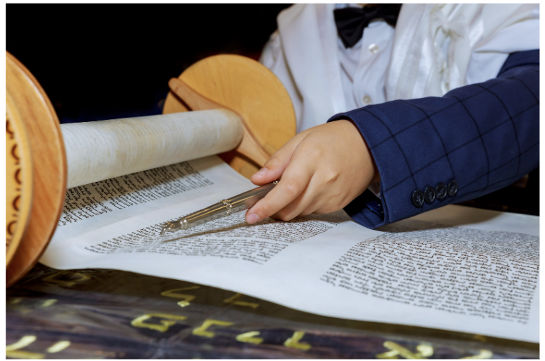
Unit 2: Teaching Trope and Hebrew to Diverse Learners

Slide 27
Unit 2 - Big Ideas
There is more than one way to teach Hebrew and trope to a student.
Exploring various options will allow you to meet the needs of each student.

Slide 28
Traditional Approach
For more sources like this, check out: https://www.pockettorah.com/

Slide 29
Color Coding
used with permission from Cantor Randall Schloss, Temple Israel of New Rochelle, New Rochelle, NY
Use highlighters to color code the portion. Have the student choose their favorite colors. Each trope/ sound is its own color! Click here for full sheet.

Slide 30
Trope Hand Signs
The student might need a gestural prompt from the person standing next to them. Each hand symbol represents a different trope.
For more videos like this one, click here.
Notes:
https://www.youtube.com/watch?v=BUhGnuwmJ4E&feature=youtu.be

Slide 31
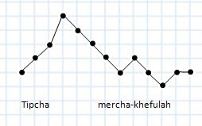
Map Out the Tune
The student might envision the trope sounds as moving up and down in a certain pattern. If they map it out themselves, they can visualize the tune!

Slide 32
Transliteration
Ber-ay-sheet bah-rah elo-heem et ha-sha-maay-eem v’et ha-ar-etz.
Click here to have the entire Torah and many blessings transliterated, translated and written as it appears in the Torah scroll.
A student might not be able to decode Hebrew text. If so, use transliteration. Either the traditional transliteration or dictate the Hebrew word and have them spell it out the way that makes sense to them. Their own spelling might not match the traditional version.

Slide 33
Recording
Some students, including non-Hebrew readers and auditory learners, may benefit from listening to their Torah portion and learning it by heart.
Use the “voice memo” app on any smartphone so the student always has access.

Slide 34
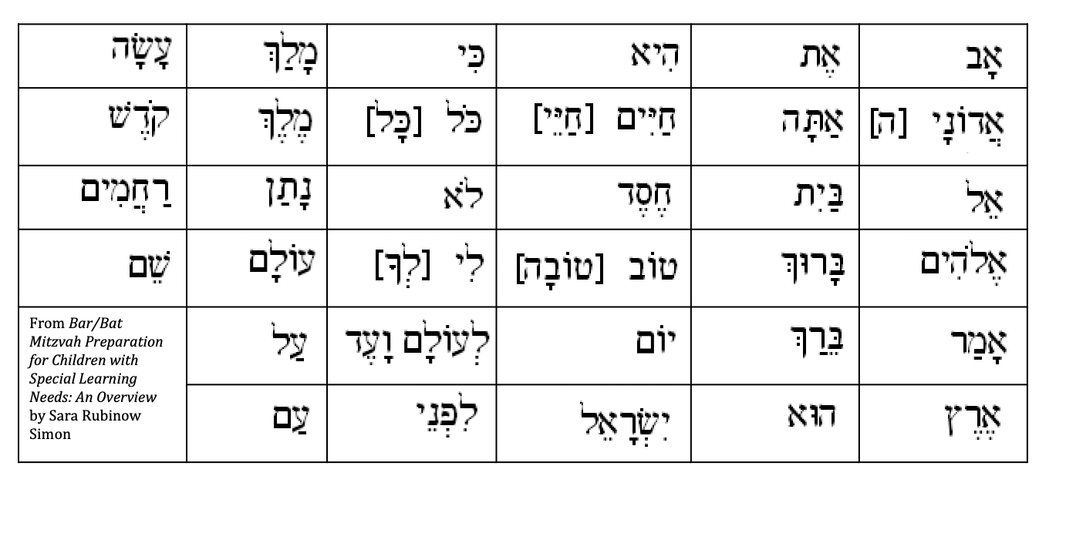
Hebrew Sight Words
This is a list of 34 common Hebrew words found in a siddur.

Slide 35
Symbol Stix
Blessings before the Torah Reading
created by Rabbi Ruti Regan, Matan consultant

Slide 36
Symbol Stix

Slide 37
Symbol Stix

Slide 38
Symbol Stix
Blessings after the Torah Reading

Slide 39
Symbol Stix

Slide 40
More Ideas
Increase the font size of the text
Tap it out - create a movement or motion that represents each trope sound (benefits kinesthetic learners)
Collaborate with schoolteachers for learning strategies the work best for the student

Slide 41
Real Life Application
Think of a student you have worked with in the past or are currently working with.
Which of the above strategies would be useful?

Slide 42
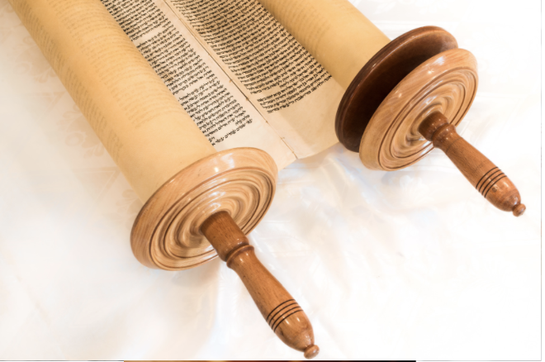
Unit 3: Tackling the D’var Torah

Slide 43
Unit 3 - Big Ideas
A d’var torah can manifest in many different ways; it does not need to only be a written speech
Understanding your students’ strengths, interests and learning styles will help you and your students establish the kind of d’var torah that will make their learning most meaningful.

Slide 44
Use of Graphic Organizers
What are they?
Practical teaching tools
Visual aides to help students organize thoughts and ideas
Allow students to visualize their ideas and make connections

Slide 45
Use of Graphic Organizers
Why?
Helps students simplify more complex ideas and language
Provides prompts for those who need help getting started
Includes pictures/visuals or choices for responses

Slide 46
Real Life Application
Identify a student you have worked with in the past.
What strategy could you have used to help develop their d’var torah?
What strategies do you want to use going forward?

Slide 47
Alternative Ideas
Pre-record a video of the student giving a speech or explanation (this can help with stage fright).
Write a skit about your Torah portion.
Create a movie about your Torah portion
Create a graphic novel/comic strip.
Write about a part of the service, a tradition in Judaism or a holiday you care about.

Slide 48
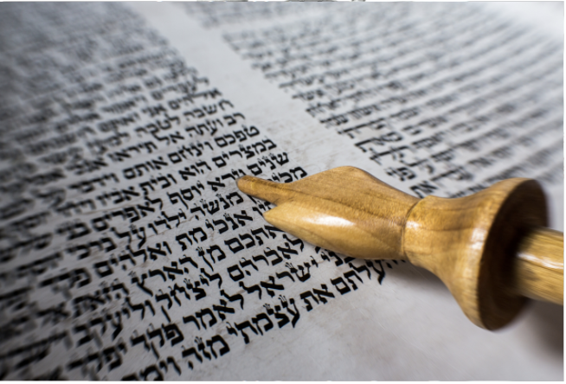
Unit 4: The Main Event

Slide 49
Unit 4 - Big Ideas
The typical b’nai mitzvah ceremony is not for everyone
Begin to shift your mindset and attitude about how to best accommodate the family you are working with

Slide 50
Why does the “typical” service not always work?
All students learn differently
All students have a variety of comfort levels
Jewish backgrounds differ
Abilities and strengths differ

Slide 51
Change Your Approach
When can the bar/bat mitzvah take place?
Shabbat afternoon (mincha)
Monday or Thursday morning
Holiday service (i.e., Purim, Hanukkah)
Rosh Chodesh (once a month)
Kabbalat Shabbat

Slide 52
Change Your Approach
Where can the bar/bat mitzvah take place?
Almost anywhere!
Family’s home/backyard
Summer camp
Retreat center
Rabbi’s study
Chapel vs. sanctuary
School
Zoom/Virtual platform

Slide 53
Change Your Approach
What parts of the service can be changed?
Shorter aliyot
Lead essential prayers only
Expression of the d’var Torah
Shorter service altogether

Slide 54
Other Possible Accommodations/Sensitivities
Nonverbal students might use a communication device/assistive technology
pre-record parts of service on device to be played out loud
Provide a schedule/set of expectations for each tutoring session so the student is prepared
Extended time/wait time: give students the time they need to process information or complete a task

Slide 55
Unit 5: Mitzvah Projects

Slide 56
Unit 5 - Big Ideas
A mitzvah project is meant to be personal and motivating to each student
A mitzvah project can be done in a variety of ways and should be tailored to meet the interests and needs of each student
Forming a personal connection to a mitzvah
project allows for more creativity, passion and
motivation from the student

Slide 57
Suggestions
Identify the students’ interests and personal preferences
Find out if the student has ever done community service/chessed work before
Educate the student on various types of mitzvah projects

Slide 58
Mitzvah Project Possibilities
Volunteering at a local food pantry
Fundraise money for a specific organization
Collect donation items (examples: toiletries, books, clothing, canned goods, sports equipment)
Hair donation
Volunteer work with children
local pre-school, Hebrew school
Volunteer work with the elderly

Slide 59
Unit 6: Case Studies

Slide 60
Unit 6 - Big Ideas
You will meet many different types of learners as a b’nai mitzvah tutor. Being intentional with your instruction will help you match your teaching to the learner in front of you.
It is important to be aware of and understand a range of disabilities, learning types and student profiles so that you can meet the needs of each student you tutor.
Not all students learn in the same way and not all students need the same accommodations in the b’nai mitzvah process. Learning about a variety of methods will help make the b’nai mitzvah experience meaningful for each child.

Slide 61
Common Special Needs

Slide 62
Case Study #1 (Sarah)
Sarah is an 11-year-old girl with a language-based learning disability. She has difficulty reading and is not on grade level with her peers. She often appears distracted in class and can be found playing with toys or fidgets at her desk. Although she is not looking at the board, she is still processing what the teacher is saying. Identifying letters in both English and Hebrew is challenging for her. If you read a passage to her, she can explain to you what happened. Sarah is very interested in playing sports and having friendly debates with her friends.
What recommendations can you make to Sarah’s bat mitzvah tutor?

Slide 63
Possible Strategies for Sarah
Read the parsha aloud to her and discuss the story line together
Have a debate about the “hot topics” in the parsha
Present the Hebrew text in small portions rather than all at once (less overwhelming to process the words)
Read the Hebrew words to her, multiple times, and have her repeat them back
Mitzvah project: donating sports equipment to those in need

Slide 64
Case Study #2 (Adam)
Adam is a 10-year-old boy on the Autism Spectrum. He loves calendars, American History and the color red. He knows how to read English and Hebrew and loves talking about his interests. Adam is in a special education school for kids with Autism and learns best through modeling, repetition and visual aides. He is in a typical Hebrew school environment and works with a 1:1 shadow to support him. His bar-mitzvah is coming up in a few years.
What recommendations would you make to his tutor?

Slide 65
Possible Strategies for Adam
Collaborate with Adam’s team both at his school and religious school
Use of color coding and/or visual representations of trope symbols (try to incorporate the color red when possible)
Create a comic strip or graphic novel about the parsha
Utilize a picture schedule/set of expectations during each tutoring session
Create a calendar together that represents a realistic study schedule
Possible mitzvah project: collecting History textbooks to be donated to schools in need

Slide 66
Possible Strategies for Jordyn
Shift your expectations: allow Jordyn to learn while walking around or moving (they are listening!)
Let them create as often as possible (i.e., paint a part of their d’var Torah)
Try to schedule tutoring sessions on weekend mornings, when they are most focused, rather than after school
Tap out the sounds of the trope or utilize hand motion symbols
Possible mitzvah project: fundraise money for their summer camp

Slide 67
Case Study #3 (Jordyn)
Jordyn is a 12-year-old with a diagnosis of ADHD. They are on grade level for their academics though really struggle to stay focused in school. They often appear to their teachers to be disruptive or uninterested in the class work. They will often play with something at their desk or pace around the room while the teacher is speaking. By the end of the day in Hebrew school, they are often hungry, irritable and hard to redirect. They love painting, playing basketball and going to summer camp.
What recommendations can you make for their b’nai mitzvah tutor?

Slide 68
Unit 7: Navigating the Big Day

Slide 69
Unit 7 - Big Ideas
Preparing for the day of the b’nai mitzvah is just as important as the rest of the process; creating a plan together will lead to higher levels of comfort for both the student and the family
Preparing for the logistics of the ceremony is crucial to the success of the student and family

Slide 70
Possible Considerations
Bring the child to the space of the ceremony multiple times to practice; let them experience what the day will be like.
Get used to the volume of the sound system in the sanctuary: too loud? Will sensory processing be impacted?
Create transliterations or visual aides to be projected for guests.
Create a seating plan: where will the child sit? parents? tutor?
Identify where the child will lead the service from: the standard bima? center of the room?
Create a “backup plan”: What happens if the child experiences anxiety or sensory overload and needs a break?

Slide 71
Thinking Ahead
Preparing for the logistics of the b’nai mitzvah can be just as important as the studying process
Questions to consider:
What accommodations can be made for each child and family?
How can we set the family up for success?

Slide 72
Unit 8: Technology, Virtual Learning and Additional Resources

Slide 73
Unit 8 - Big Ideas
As the world continues to shift around us, technology and virtual learning are becoming more and more necessary.
Expose yourself to a variety of technology, distance learning platforms and additional resources that will help you in the b’nai mitzvah education process

Slide 74
Zoom- Tricks of the Trade
There are many settings that can be changed on zoom.us/profile/settings.
Some suggestions:
Chat feature: allow student to type their response rather than say it out loud.
Screen share: open the text in Sefaria (or any other text platform) and have the student follow along with you.
White Board- takes notes/draw images together. Allow the student to have “annotating” permissions.
Record your session: allow student to review the content of the session at a later date.

Slide 75
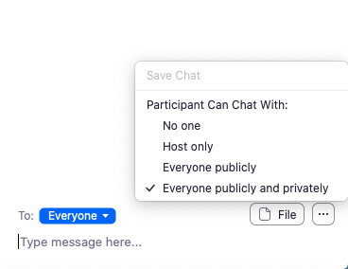
Chat
Basic Information | What are the benefits?
Participants can chat send a chat to everyone, just the host, or a specific participant. Host can change chat settings: | Allow students to type and share their response using written rather than verbal expression. Wait time: offer the option to type your reply and only press “enter” once a set amount of time has been given to think and process the question prompt Practical use: Brainstorm ideas about the d’var torah together

Slide 76
Annotate
Basic Information | What are the benefits?
When sharing your screen, you have the option to annotate with the following features: | Highlight important information Block out portions of screen share Take notes over another document Some ideas: Use the highlighting feature to color code the text by trope symbol Underline important parts of the Torah portion Use the “stamp” to identify parts of the Torah portion that stand out to you

Slide 77
Share Screen
Basic Information | What are the benefits?
Display any web content, videos, games, quizzes, documents, etc. | Share only specific pages, not entire desktop. Some ideas: Share the text you are reading from Share a google document and write the d’var torah together Share images of the sanctuary to set expectations Share a video of trope hand motions

Slide 78
Additional Technology Platforms
Jamboard (a collaborative working platform powered by Google)
SeeSaw (a paid platform that allows students to share their work)
Google Docs, Slides, Classroom, Forms (can be shared with tutor and student simultaneously)
Flipgrid (allows students and teachers to share videos with one another)

Slide 79
Additional Resources for B’nai Mitzvah Support
Gateways for Jewish Education
Sefaria.org: Hebrew and transliterated Torah text with trope
Bible.ort: transliterated, translated and Torah scroll version of all text
Howard Blas

